Slide 1
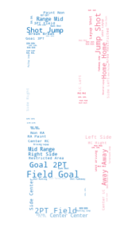

Gabriel Alves
Scott Boxberger
Erik Figge
Kobe Bryant. He Shoots. He Scores?

Slide 2
Does kobe shoot a lot?

Slide 3

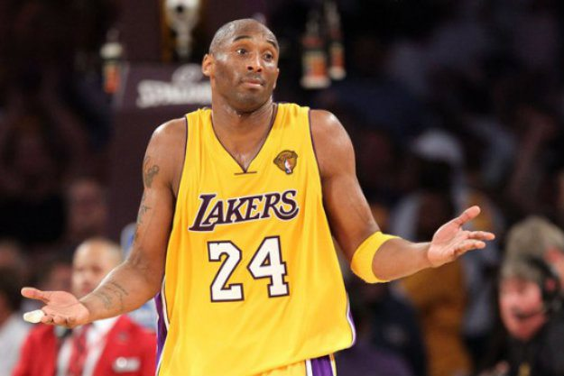

Slide 4
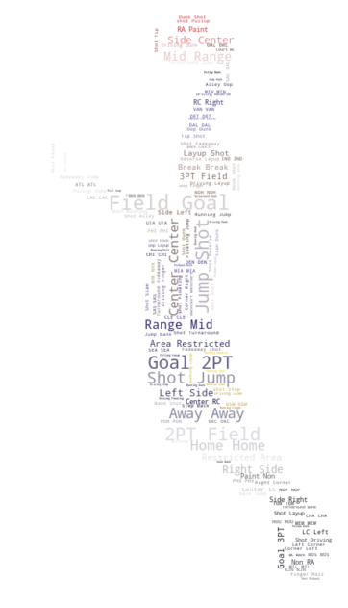
Is Kobe Clutch?

Slide 5

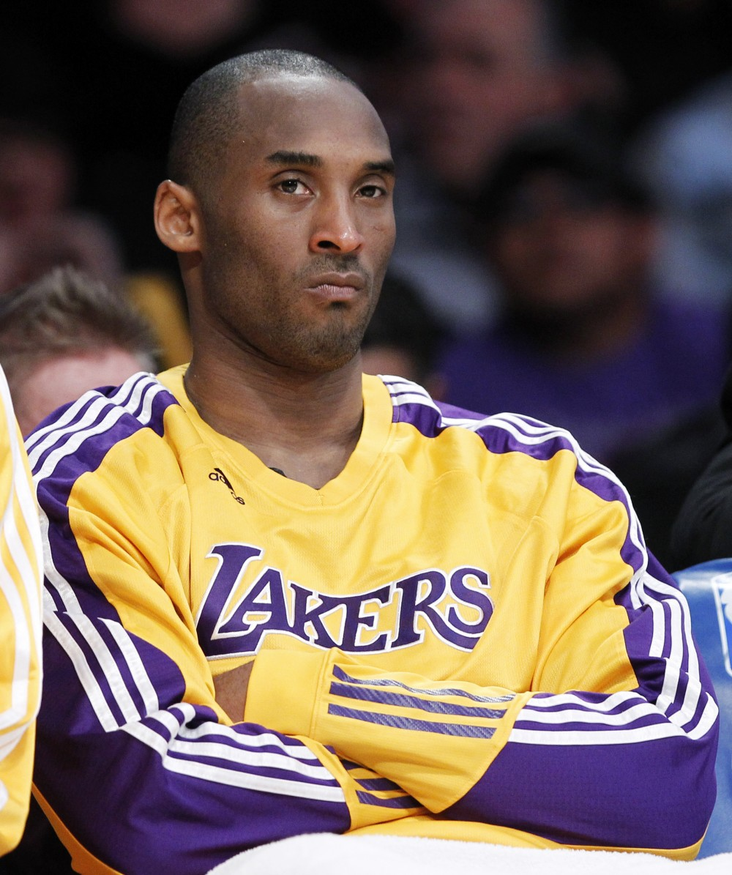

Slide 6
The end
Questions?

Slide 7
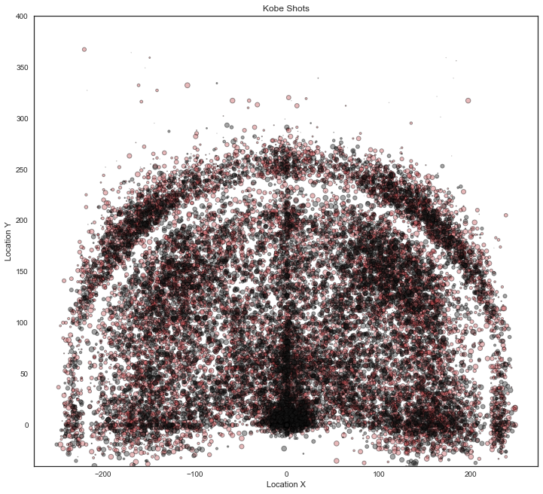
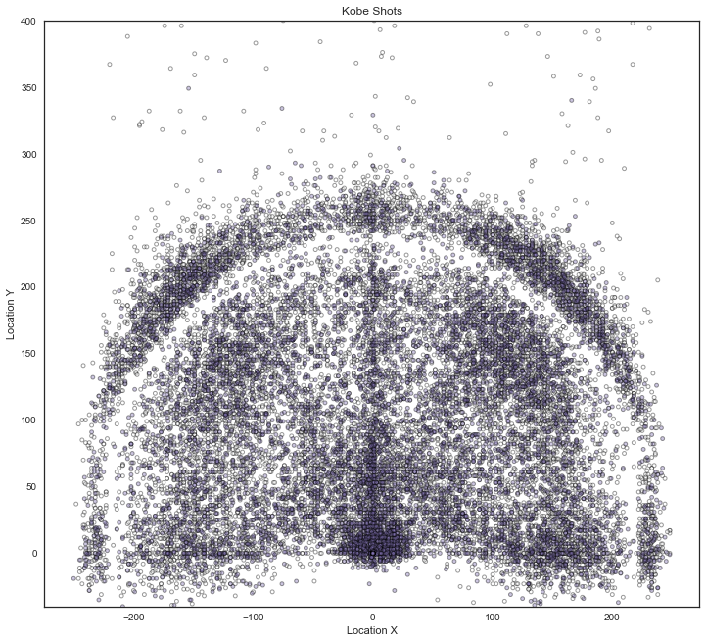
Location x vs location y

Slide 8
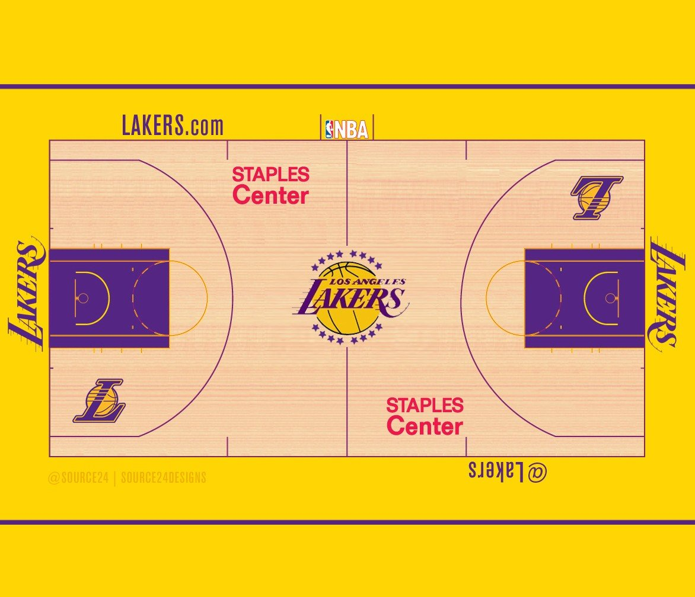
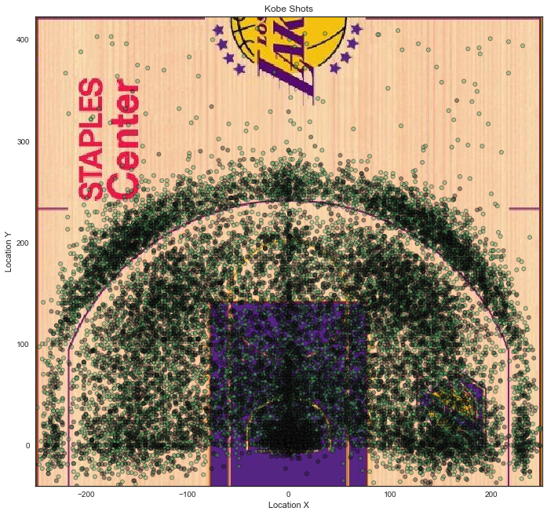
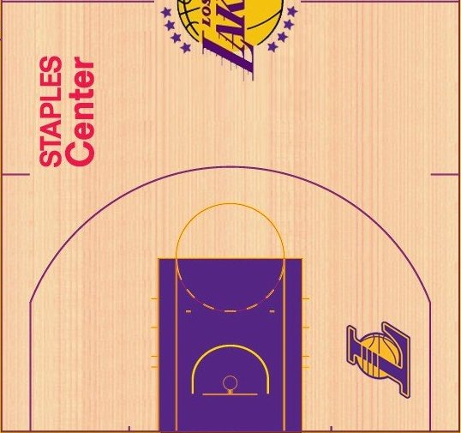
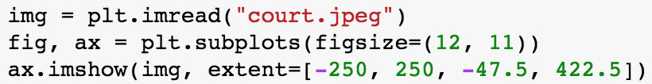
Background Court
Original Image
Cropped and rotated

Slide 9
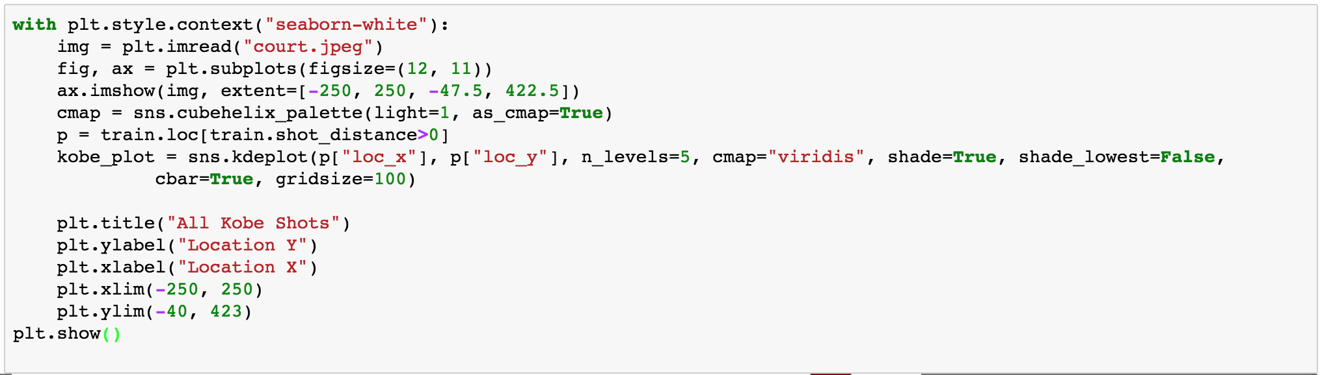
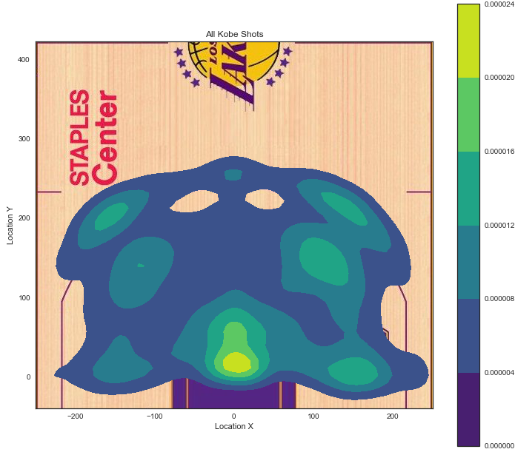
SHOT ATTEMPT HEAT MAP

Slide 10
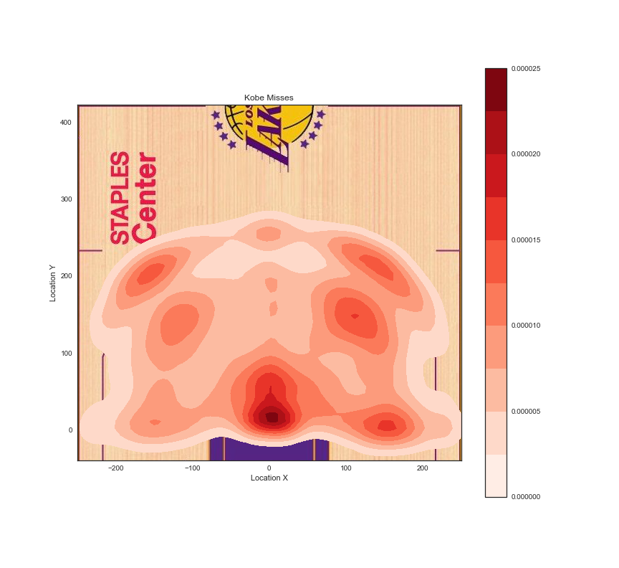
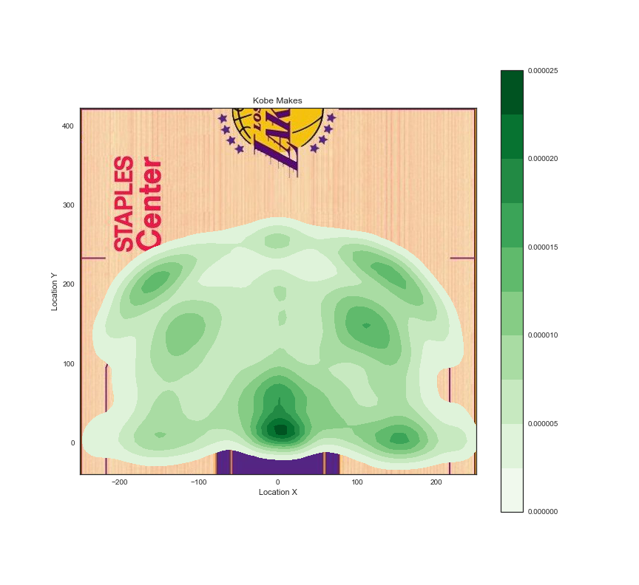
Splitting Makes and Misses

Slide 11
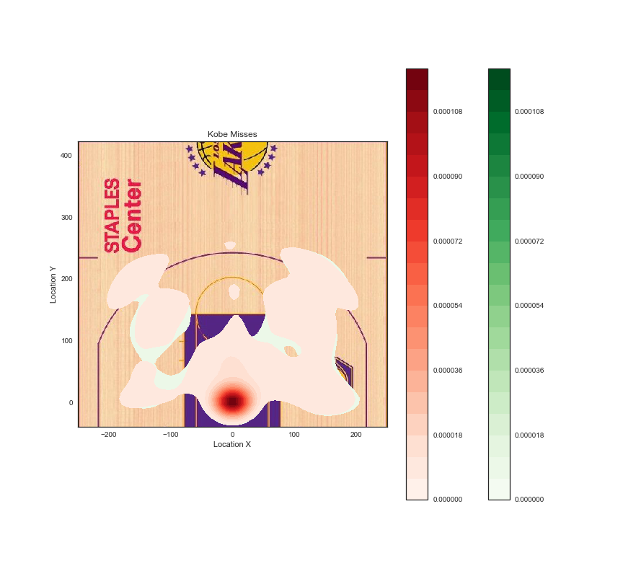
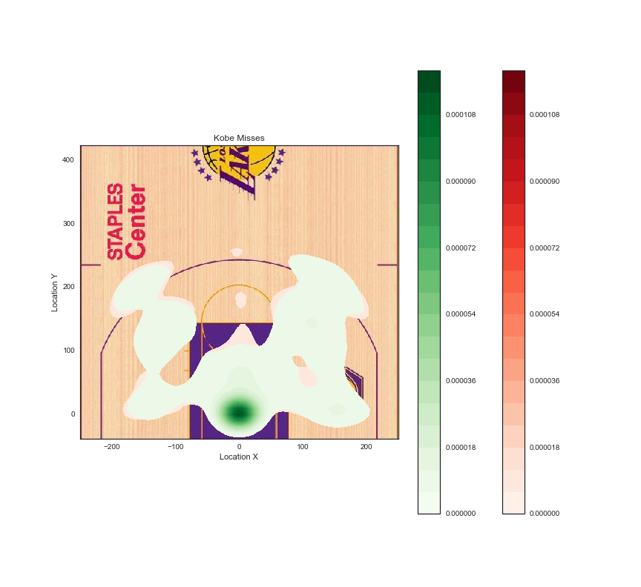
Changing Smoothness Levels

Slide 12
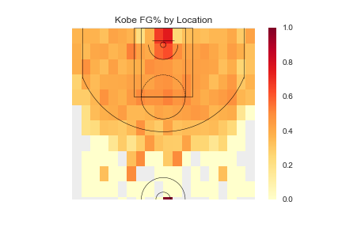
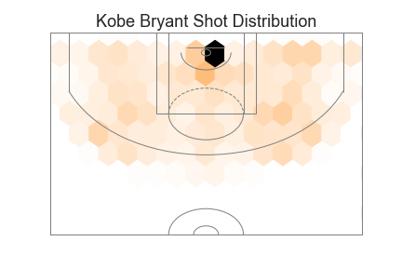
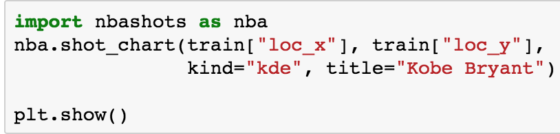
NBA Shots Python Library

Slide 13
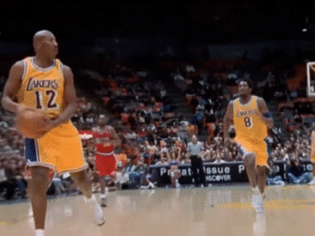
Interactive Plots with Tableau

Slide 14

Data

Slide 15

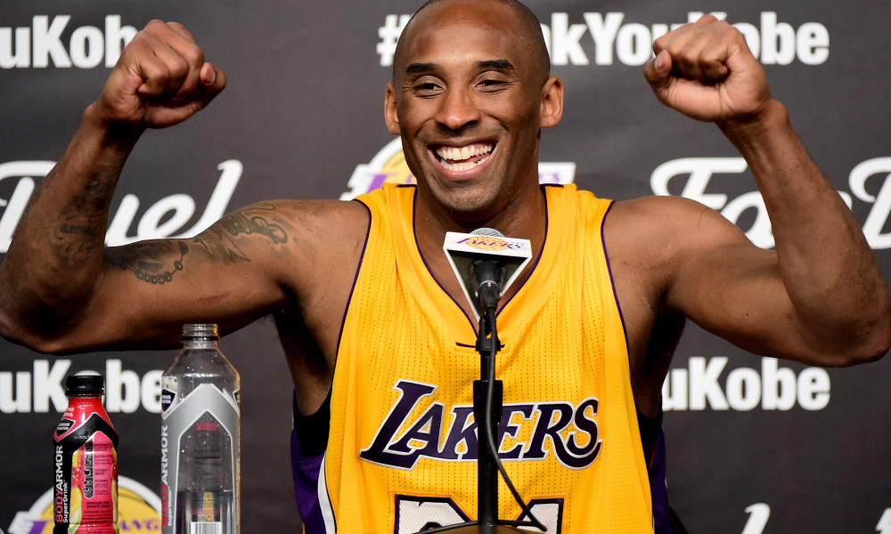
Model Results
Model Type | Parameter Comments | Accuracy | Kaggle Score
Deep Neural Network | Two hidden layers (100 nodes each) Activation: relu, softmax | 0.682645914 | 7.11766
Random Forest | n_estimators=50 max_features=sqrt | 0.631284047 | 1.98653
Gradient Boosting | max_depth: 4 max_features: log2 min_samples_leaf: 4 min_samples_split: 7 n_estimators: 50 | 0.679495661 | 0.90566
Logistic Regression | C=1.0 class_weight=None dual=False fit_intercept=True intercept_scaling=1 max_iter=100 multi_class=ovr penalty=l2 solver=liblinear tol=0.0001 | 0.682645914 | 0.97507
Average (all 4) | unweighted | N/A | 0.97544
Average (all except NN) | unweighted | N/A | 0.96848
Average (GB & LR) | unweighted | N/A | 0.93108
Weighted Average (GB & LR) | 80-20 | N/A | 0.91434
Weighted Average (GB & LR) | 90-10 | N/A | 0.90977
Weighted Average (GB & LR) | 95-5 | N/A | 0.90766
Weighted Average (GB & LR) | 99-1 | N/A | 0.90605

Slide 16
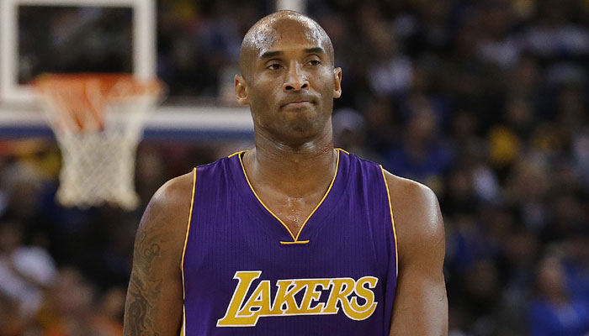
Competition results
Kaggle Top Score | 0.56528
Our Best Result (Gradient Boosting) | 0.90566
Rank | 981
Total Participants (Closed) | 1117
Just like Kobe in the final seconds

